Slide 1
TOPIC
Add picture (Optional)
NAME:
TITLE:
Name:
Title:

Slide 2
Disclosure Statement
“This information is furnished on the condition that it will not be released to another nation without specific authority of the Department of the Air Force of the United States, that it will be used for military purposes only, that individual or corporate rights originating in the information, whether patented or not, will be respected, that the recipient will report promptly to the United States any known or suspected compromise, and that the information will be provided substantially the same degree of security afforded it by the Department of Defense of the United States. Also, regardless of any other markings on the document, it will not be downgraded or declassified without written approval of the originating US Agency, AFLCMC/WAQIB - TCP, 320 Richard Ray Blvd, Robins AFB GA 31098-1670”.
This briefing is for information only. No US Government commitment to sell, loan, lease, co-develop or co-produce defense articles or provide defense service is implied or intended.”

Slide 3
WHO WE ARE

Slide 4
WHAT WE DO

Slide 5
WHY WE EXIST

Slide 6
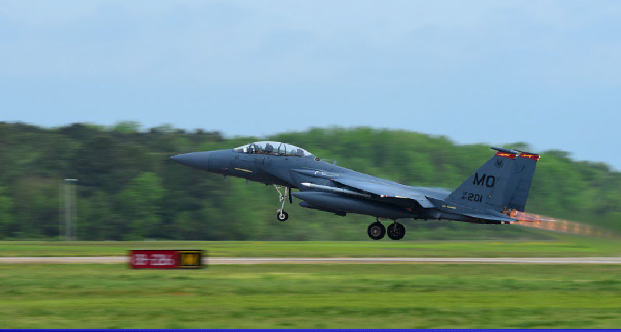
Questions, Comments, Feedback

